Slide 1



Slide 2
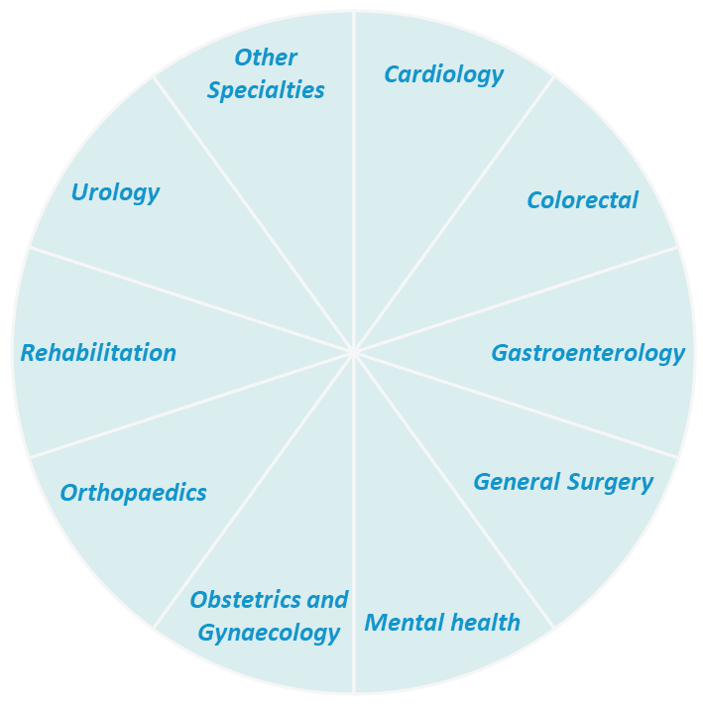
HEALTHE CARE AUSTRALIA PTY LTD
Healthe Care is Australia’s largest privately owned private hospital operator.
It is provider of medical, surgical and psychiatric healthcare services.
The company provides outpatient services including workplace rehabilitation and community nursing, enabling the patients to avail the services as desired.
Established
2005
Facilities
18
Beds
1200
Operating Theatres
70+
Management of Hospitals
Disciplined Corporate Framework
Led by a proactive, 'hands: on' executive team.
Ensures consistency, efficiency, and high standards across all operations.
Empowered Local Management
Strong teams at each hospital with the autonomy to address local challenges.
Encourages innovation and tailored solutions for unique operational issues.
Speciality
Services

Slide 3











Mental Health
Day Therapy Programs
Acute Psychiatry Services
Treatment for Addictive
Disorders
Adolescent Mental Health Care
Cognitive and Dialectical
Behavior Therapy Programs
Inpatient Therapy Programs
Advanced Neurostimulation
Treatments
PTSD Programs
Specialized Care for Older Persons
and Perinatal Mental Health
Regional and Special Care Services
Treatment for Trauma and Dissociation

Slide 4
Mental Health
Day Therapy Programs A broad spectrum supporting recovery and wellness.
Acute Psychiatry Specialized care in adult and community services.
Addictive Disorders Comprehensive treatment for addiction.
Adolescent Care Tailored programs for younger patients.
Therapy Programs Cognitive Behavioral Therapy (CBT) and Dialectical Behavior Therapy (DBT).
Inpatient Therapy Dedicated inpatient care programs.
Neurostimulation Advanced treatments including ECT and TMS.
Older Persons & Perinatal Mental Health Specialized care for diverse age groups and needs.
PTSD Programs Focused support for defence and emergency services personnel.
Regional & Special Care Services Accessible and tailored care for specific needs.
Trauma and Dissociation Specialized treatment for trauma: related disorders.
Client Testimonial
“I experienced depressive episodes as a child and overdose. Brisbane Water Private Hospital is recommended for its support and care. The staff's respect and tools helped me overcome depression and live a life like everyone else.”
Yvonne Bullock

Slide 5
Executive Team Structure
Executive Team
Matt Hanrahan
Chief Executive Officer
Stephen Berry
Chief Financial Officer
Warren Kulpa
Chief Information Officer
Karen Gallagher
Head of Commercial Operations
George Diakos
Head of Human Resources
Bernie Lyons
Head of Risk and Compliance
Rav Carothers
Head of Health Fund Relations
Haydn Murray
Head of Marketing and Communications

Slide 6
National Management Team
Alex Demenis : General Manager Finance
Simon Chan : Finance Manager Public Health
Lynne Simpson : Head of Group Procurement
Karen Hastings : National Health Information Manager
Bev Berkley : National Billing Manager
Devinder Jain : National Payroll Manager
Sarah Vandervoort : National People Advisor
Di Nicholson : National Quality Manager
Benjamin Mastronardi : National Quality Systems Manager
Alana Perry : National Contracts & Analytics Manager
Elise Andrusiow : National WebPAS Manager
Greg Campbell : National Manager : Development and Construction
Jason Lees : National Facilities Manager
Brianna Pike : Commercial Manager

Slide 7
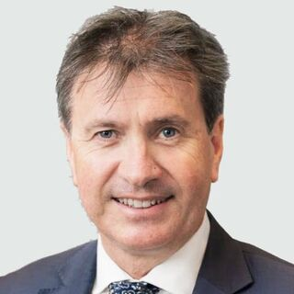
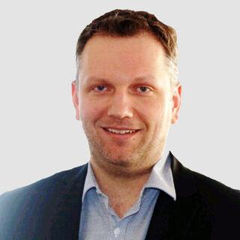
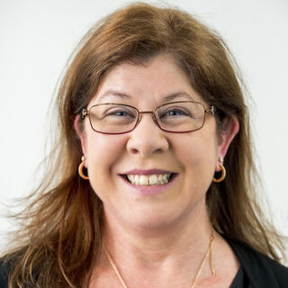
Executive Team Biographies
Matt Hanrahan
Chief Executive Officer
Matt Hanrahan is an accomplished healthcare executive with a track record of leadership excellence. As the CEO of Healthe Care, he brings over a decade of experience driving strategic growth and operational efficiency in the healthcare sector. Prior to Healthe Care, Matt served as Deputy CEO at Calvary Health Care and previously as CEO at the Central Coast Local Health District. With a commitment to patient: centric care and organizational sustainability, Matt is dedicated to delivering high: quality healthcare services across Australia.
Warren Kulpa
Chief Information Officer
With over two decades of IT and healthcare management experience, Warren is serving as the Chief Information Officer at Healthe Care. Prior roles include Director of IT Infrastructure at Peninsula Health and positions at Computershare and HIH Insurance. Since joining Healthe Care in December 2023, Warren has been instrumental in driving digital transformation initiatives.
Karen Gallagher
Head of Commercial Operations
Karen has extensive experience in the healthcare sector, having spent over 25 years in a range of management roles including Health Information Management, Quality, and Commercial Management. Karen also held the positions of Chief Executive Officer of Lingard Private Hospital, Deputy Chief Operating Officer for Healthe Care and most recently Executive Manager for Northern NSW, New Zealand, Health Information and Quality. She is particularly passionate about Commercial and Strategic Management, Quality Program Development, and Corporate and Clinical Governance, and has overseen many service developments and building projects within healthcare facilities. Karen has a Bachelor of Business (Accounting and Human Resource Management) and is currently completing a Master of Business Administration.

Slide 8
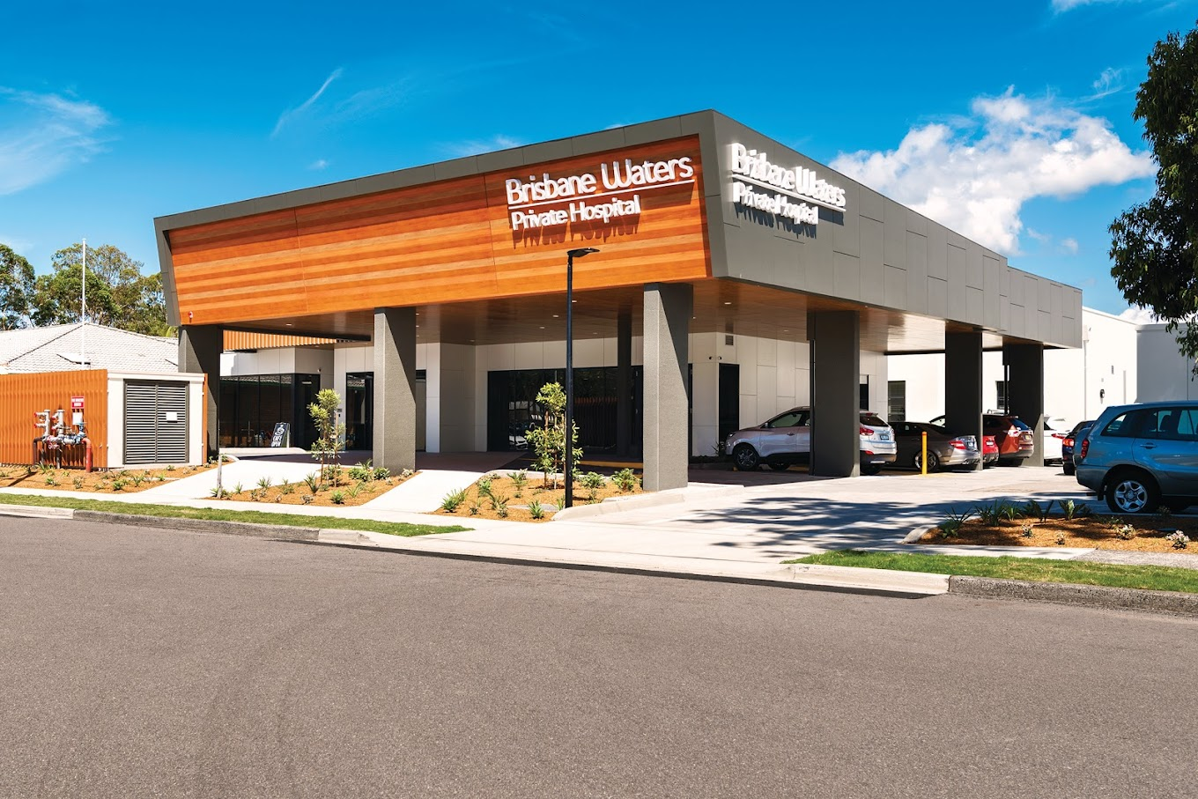
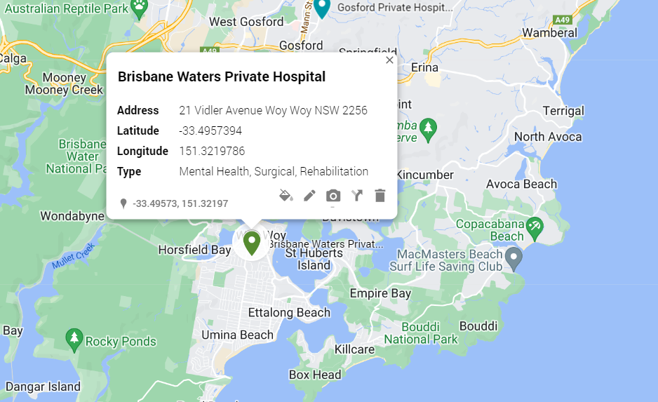
Brisbane Waters Private Hospital
Rating
3.8 (47)
Area Population
12,977
Key Mental Health Doctors:
Dr. Priyanga Arachchi
Dr. In Ho (Eric) Choi
Dr. Dominic Paul
Dr. Wimaladharma Ranasinghe
Dr. Susil Stephen
Dr. Christopher Wellard
Competitors:
Woy Woy Hospital: 4.1(11)
Woy Woy Rehabilitation Centre
Local GP Surgeries:
Woy Woy General Practice: 2.5 (59)
Woy Woy Family Practice : Local Central Coast Doctors: 4.6 (360)
Bluesky Medical: 3.9 (25)
Perfect Medical Care: 4.0 (55)
Dr. Kam Simon: 5.0 (3)
Negative Google Reviews
Understaffed & Dirty
Unprofessional conduct
Poor staff attitude
Lack of discharge planning
Inpatient Beds
136
Operating Theatres
4
Day Surgary Unit
Yes
Rehabilitation & Research Unit Beds
34
Mental Health Unit Beds
68

Slide 9
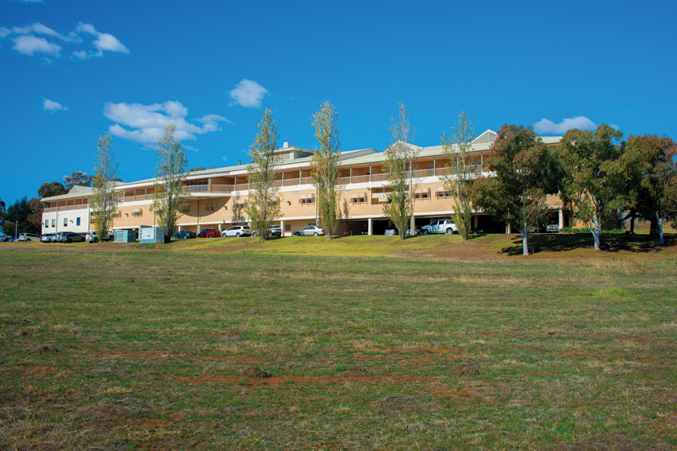
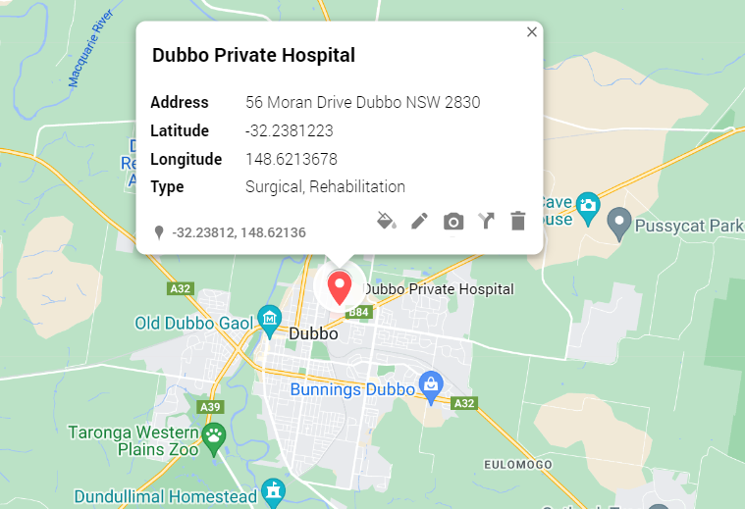
Dubbo Private Hospital
Rating
3.6 (14)
Area Population
43,512
Key General Surgery Doctors:
Dr. Dean Fisher
Dr. Chandika Liyanage
Dr. Angelina Di Re
Dr. Mark Rice
Competitors:
Dubbo Base Hospital: 3.0 (113)
Walanmarra (Lourdes Hospital)
Local GP Surgeries:
Dubbo Family Doctors: 3.5 (14)
Macquarie Valley Family Practice: 4.0 (4)
Dubbo Medical & Allied Health Group: 3.0 (8)
DubboCare Family Practice: 3.0 (10)
Bultje Street Medical Centre: 5.0 (3)
Western Plains Medical & Dental Centre: 3.0 (323)
Dubbo Health Hub: 5.0 (65)
Negative Google Reviews
Bad experience
Lack of care
Beds
53
Operating Theatres
3
Day Surgary Unit
Yes
High Dependency Beds
4
Children Ward
4 (beds)

Slide 10
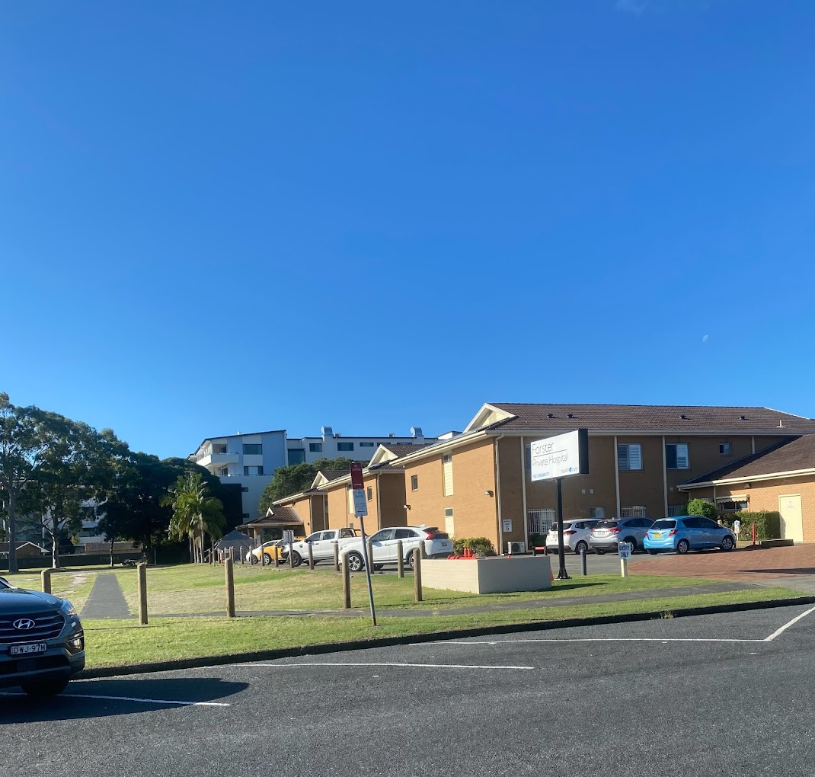
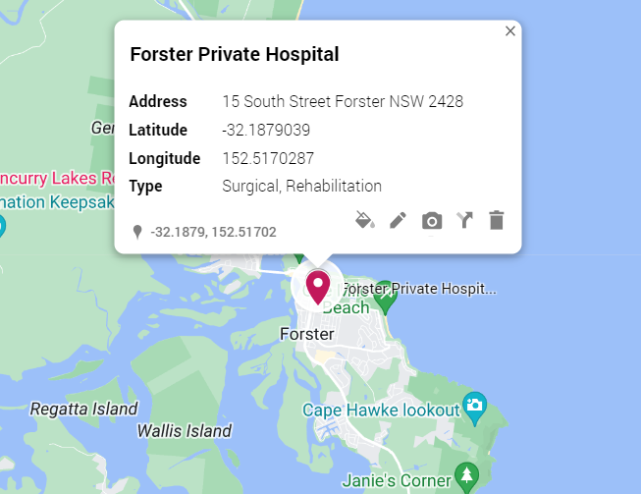
Forster Private Hospital
Rating
3.4 (16)
Area Population
21,076
Key General Surgery Doctors:
Dr. Saad Al: Mahaidi
Dr. Senan Al: Mahaidi
Dr. Louise Clarke
Dr. Sami Dayoub
Dr. Moheb Ghaly
Professor Anubhav Mittal
A/Prof Garett Smith
Competitors:
Forster Community Health : 4.1 (9)
Forster Tuncurry Medical Centre : 2.8 (69)
Tomaree Community Hospital : 3.4 (75)
Manning Base Hospital : 3.2 (134)
Gloucester Soldiers' Memorial Hospital : 4.2 (14)
Local GP Surgeries:
West Street Medical Centre: Forster: 3.6(17)
Wallis Street Medical Centre: 3.1(8)
Negative Google Reviews
Misdiagnosis, unethical behavior
Call for closure
Inpatient Beds
69
Operating Theatres
2
Day Surgary Unit
Yes
Rehabilitation Unit
Yes

Slide 11
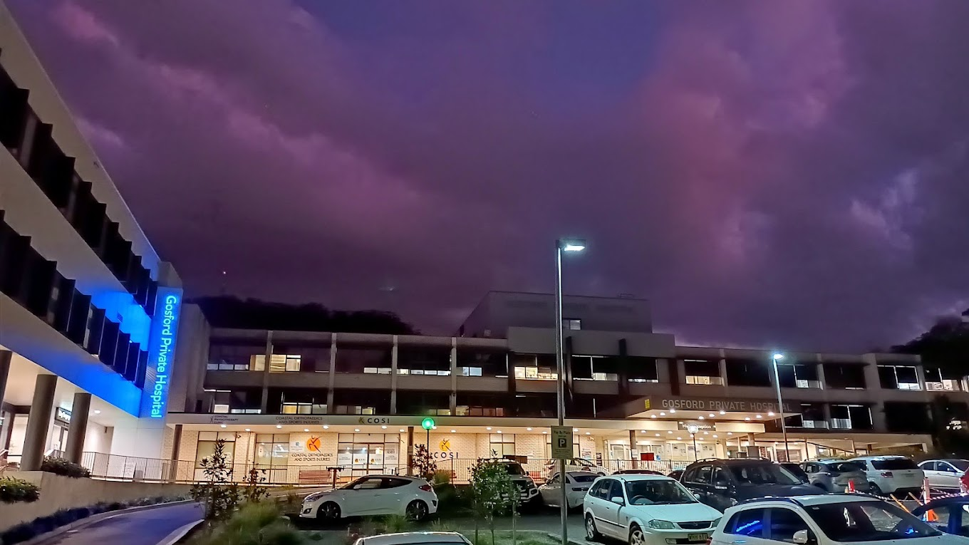
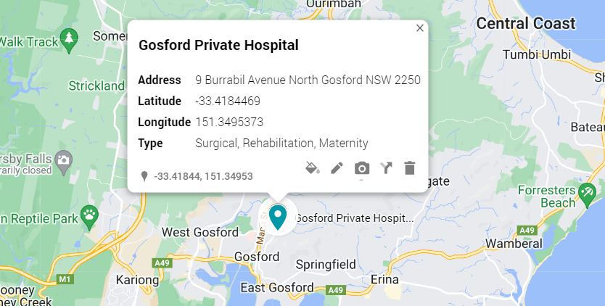
Gosford Private Hospital
Rating
4.0 (89)
Area Population
178,136
Key General Surgery Doctors:
Competitors:
Gosford Hospital
Gosford Specialist Day Hospital
Local GP Surgeries
Pacific Family Medical Centre : 4.5 (20)
Caligem Health : 4.8 (495)
SPRING MEDICAL GROUP : 4.6 (313)
Spring Emergency Centre : 4.8 (20)
Bridges After Hours GP Clinic Erina : 3.0 (30)
Absolute Medical Services : Dr. John Schulze : 3.0 (6)
Point Clare Surgery : 4.4 (13)
Negative Google Reviews
Poor post: surgical care
Rushed, inadequate care
Disrespectful treatment
Medication oversight
Facility discomforts
Inpatient Beds
148
Operating Theatres
12
Day Surgary Unit
Yes
Critical Care Beds
14
Private Birthing Suits
3

Slide 12
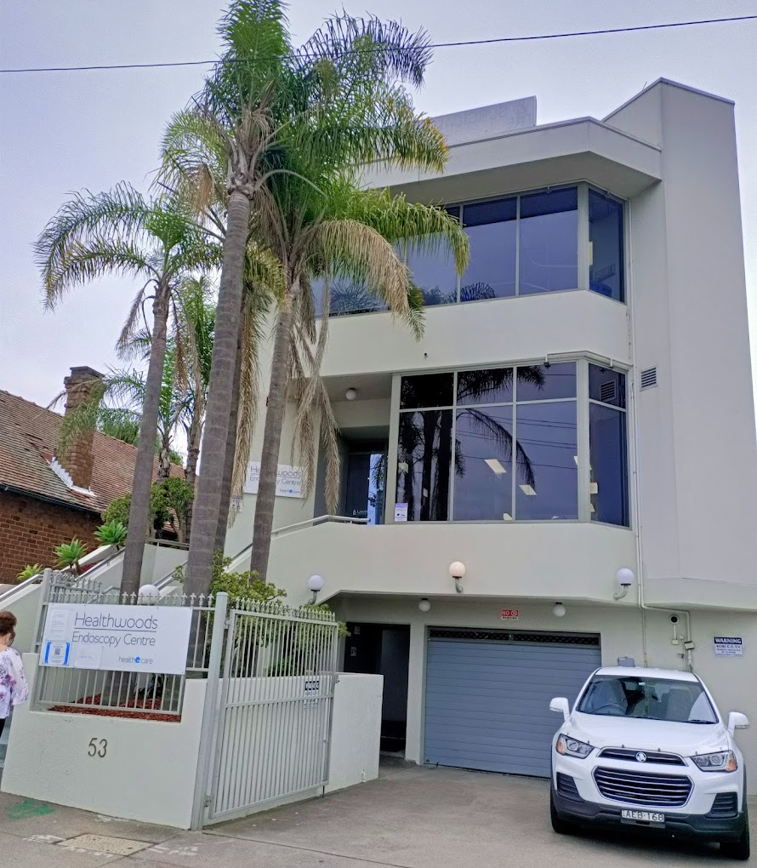
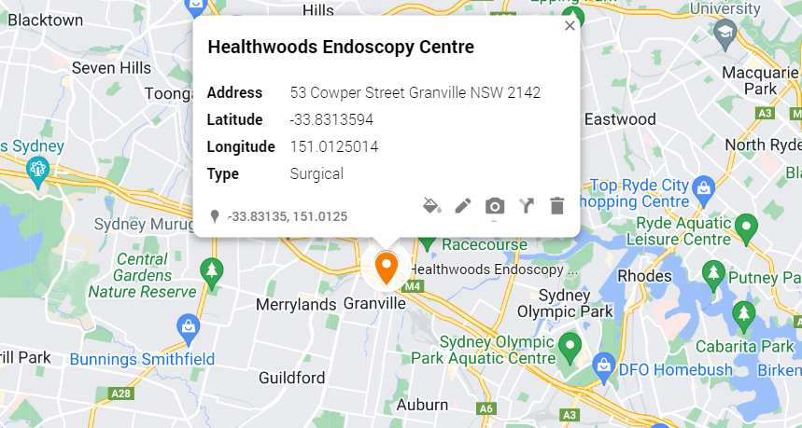
Healthwoods Endoscopy Centre
Rating
3.9 (67)
Area Population
10,769
Key Consulting Doctors:
Dr. Tasos Nicolaou
Dr. Tady Kordian
Competitors:
Royal Prince Alfred Hospital : 3.5 (728)
Royal North Shore Hospital : 3.7 (640)
St George Hospital : 3.2 (482)
Prince Of Wales Hospital : 3.2 (449)
St Vincent's Private Hospital Sydney : 3.9 (398)
Hornsby Ku: ring: gai Hospital : Rating: 3.5 (362)
Sydney Adventist Hospital : Rating: 4.0 (359)
Local GP Surgeries
New Granville Medical & Dental Centre: 3.8 (57)
Granville Family Medical Centre: 2.9 (79)
Clyde Street Medical Centre: 4.1 (50)
Dellwood Medical Centre: 4.1 (106)
Negative Google Reviews
Dr. Nicolaou's rudeness (for last 3 years)
Disregard for appointment times.
Extended procedure delays
Poor customer service.
Procedures
4,000
Patient Satisfaction %
96
Specialists
30

Slide 13
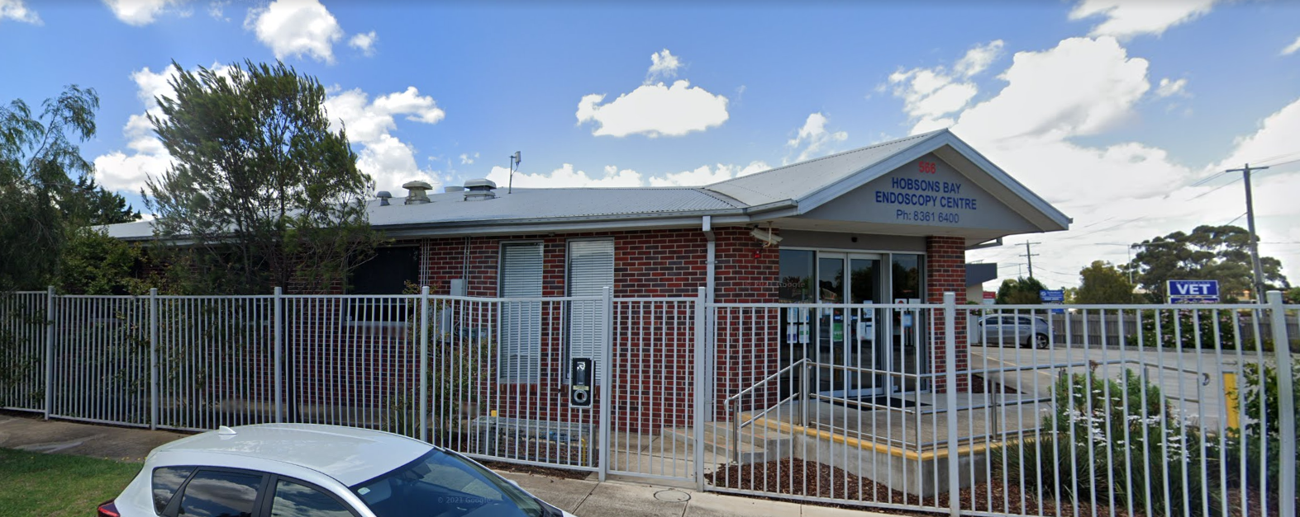
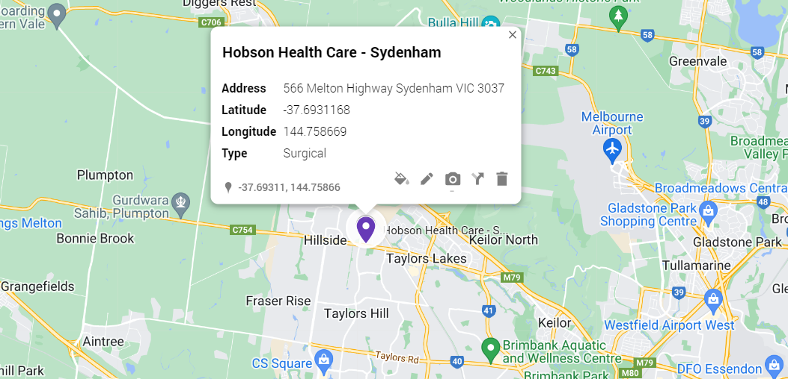
Hobson Health Care : Sydenham
Rating
4.1 (19)
Area Population
8.33 m
Key General Surgery Doctors:
Associate Professor Shiran Wijeratne
Assoc. Professor Peter Nottle
Dr Jal Bhathawalla
Mr Douraid Abbas
Competitors:
Royal Prince Alfred Hospital : 3.5 (728)
St George Hospital : 3.2 (482)
Prince Of Wales Hospital : 3.2 (449)
St Vincent's Private Hospital Sydney : 3.9 (398)
North Shore Private Hospital : 3.9 (199)
St George Private Hospital : 3.8 (199)
Royal North Shore Hospital : 3.7 (640)
Westmead Private Hospital : 3.7 (291)
Mater Hospital : Rating: 4.1 (208)
Local GP Surgeries:
Sydenham Green Group Practice : 1.9 (210)
Medicspot Clinic Sydenham : 5.0 (3)
Wells Park Practice : 2.3 (152)
Negative Google Reviews
Dismissive, Unreassuring
Procedures
8,000
Patient Satisfaction %
96
Specialists
30

Slide 14
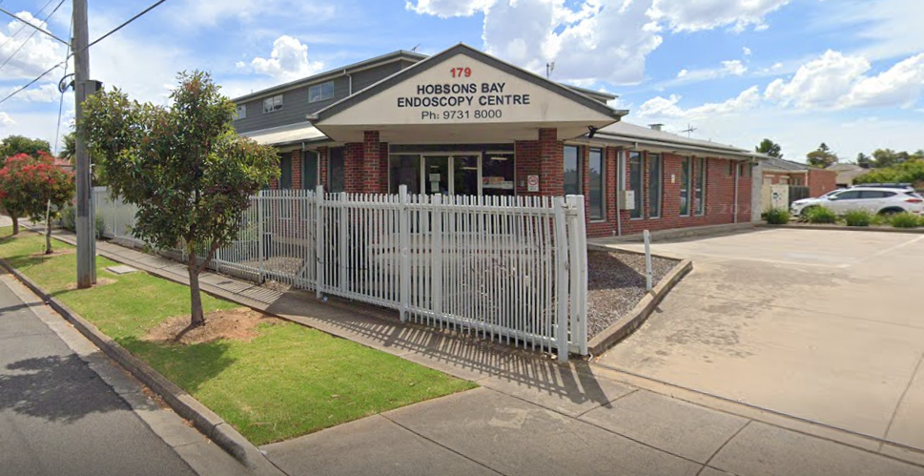
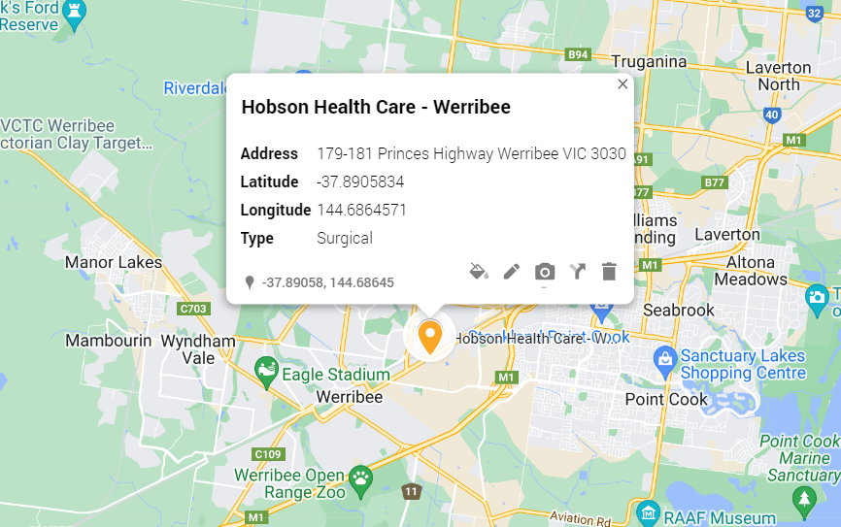
Hobson Health Care : Werribee
Rating
4.1 (28)
Area Population
50,027
Key General Surgery Doctors:
Mr Hai Bui
Dr Matthew Croxford
Dr Michael Hong
Mr Chris Lu: General Surgery, Laparoscopic
Dr Mohammad Rafique
Competitors:
Werribee Mercy Hospital : 2.1(929)
St Vincent's Private Hospital Werribee : 4.4(70)
Local GP Surgeries:
Hoppers Lane General Practice : 4.5(534)
Alfred Road Medical Centre : 4.7(119)
Werribee Medical & Dental Centre : 3.7(918)
WestView Medical Centre Werribee : 5.0 (24)
MyClinic Werribee Village : 2.7(123)
Werribee Health Care : 3.2(77)
The Clinic Complete Family Medical & Skin Centre : 4.3(99)
Wyndham Health Care : 2.2(203)
Negative Google Reviews
All negative are 2 to 5 years old.
Procedures
8,000
Patient Satisfaction %
96
Specialists
30

Slide 15
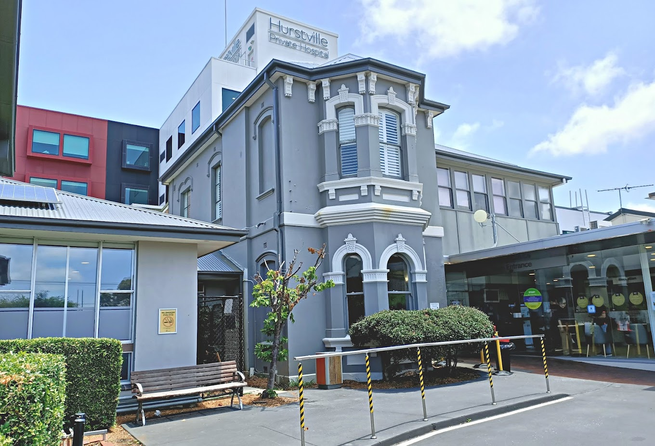
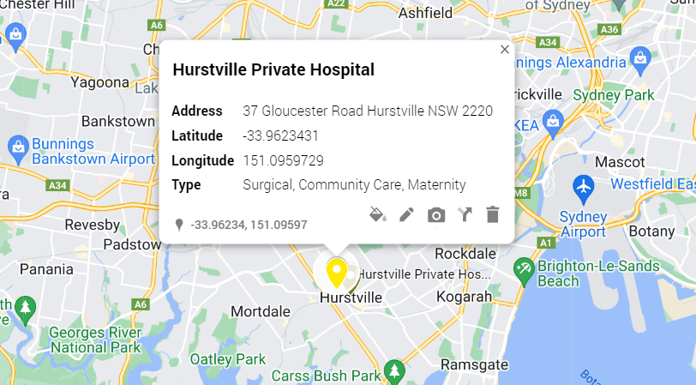
Hurstville Private Hospital
Rating
3.8 (117)
Area Population
31,444
Key General Surgery Doctors:
A/Prof Kim: Chi Phan: Thien
A/Prof Garett Smith
Assoc. Prof. Michael Talbot
Prof. Denis King
A/Prof David Lubowski
Competitors:
Waratah Private Hospital: 3.6 (135)
Local GP Surgeries:
South Hurstville Family Practice : 4.9(305)
Criniti Medical Practice : 4.9(256)
MedFirst Medical Centre : 4.5(971)
Hurstville City Medical Centre : 3.6(527)
Myhealth Hurstville : 3.5(403)
Hurstville Medical Practice : 3.5(162)
Negative Google Reviews
Hygiene Neglected
Car Park Frustration
Lack of Communication
Neglectful/Improper Care
Misleading No GAP Program
Inpatient Beds
167
Births (2021)
1000
Credentialed doctors (2018)
360
Total Operations (2018)
12,000
Acquired by
Healthe Care
May 2012

Slide 16
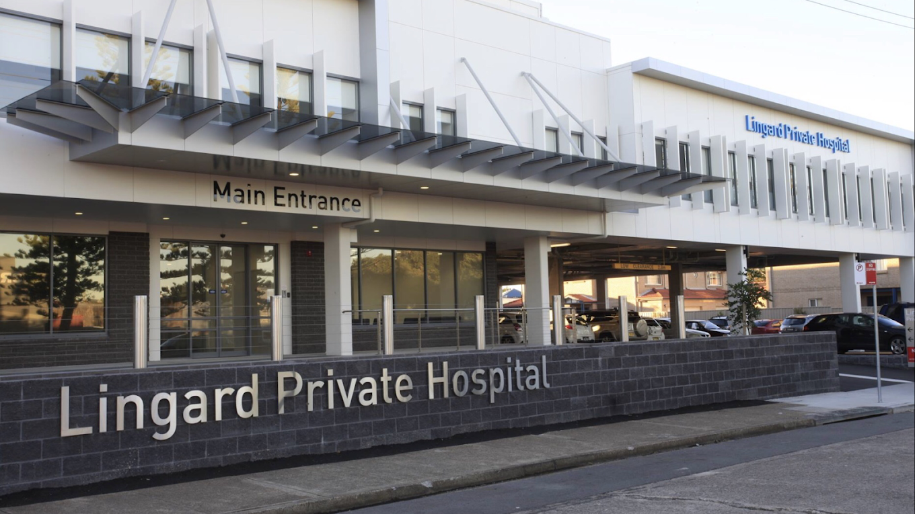
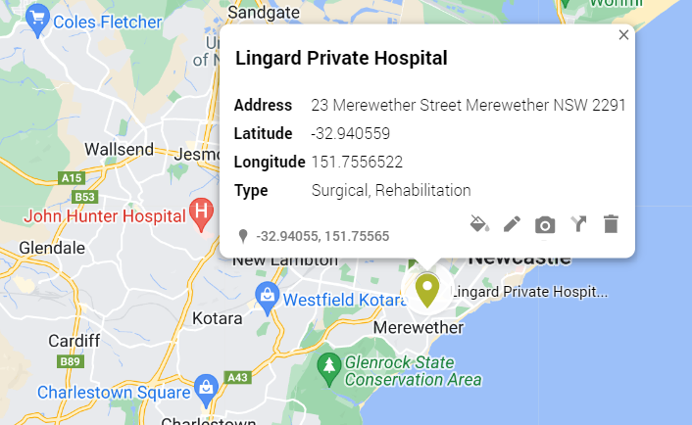
Lingard Private Hospital
Rating
3.7 (86)
Area Population
13,351
Key General Surgery Doctors:
Dr Anthony Azzi
Dr James French
Dr Martin McLeod
Adj. Assoc. Prof. Peter Pockney
Dr Clifton Washaya
Dr Tim Wright
Competitors:
Lingard Day Centre : 4.0(19)
Lingard Medical Centre : 5.0(1)
Local GP Surgeries
Merewether Ridge Street Surgery : 5.0(17)
Merewether Family Practice : 3.3(12)
Merewether The Junction General Practice : 3.6(10)
Negative Google Reviews
Overcrowded Waiting
Unprofessional Examination
Rushed Discharge
Equipment Malfunction
Lack of Transportation Support
Inhumane Treatment
Overnight Beds
125
ICU Beds
12 out of 125
Operating Theaters
14
Cardiac Catheter Labs
2
Endoscopy Suits
2
Operations (2022)
23,407

Slide 17
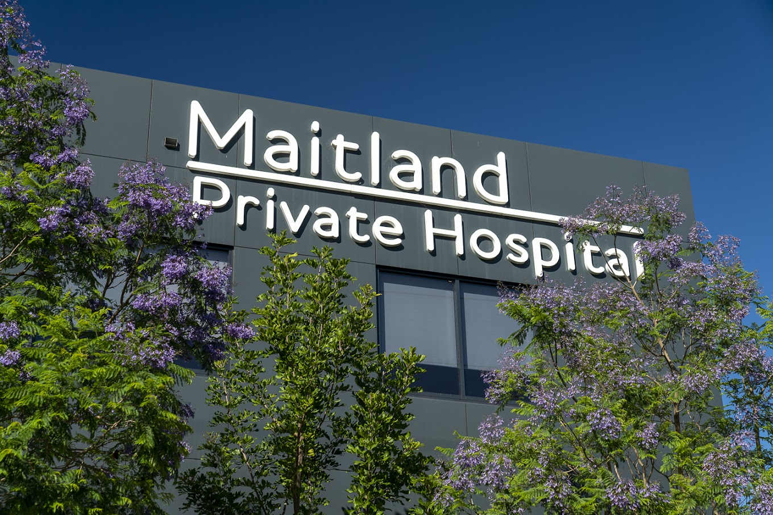
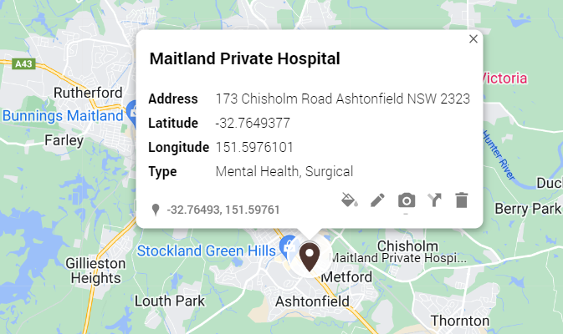
Maitland Private Hospital
Rating
3.8 (13)
Area Population
4,579
Key Mental Health Doctors:
Dr Subhra Bhattacharyya
Dr Anthony Llewellyn
Dr Geoffrey Robinson
Dr Christopher Wellard
Dr Jenny Young
Competitors:
Heal Specialist Urgent Care : 4.9(168)
Hunter Valley Private Hospital : 3.7(36)
Hunter Respiratory and Sleep Centre : 4.8(85)
John Hunter Hospital : 3.2(453)
Local GP Surgeries
East Maitland Family Medical Centre : 4.6(672)
Dr Hardeep Salaria : 4.5(11)
Providence Medical Thornton : 4.0(123)
Dr. Malanie Hettiarachchi : 5.0(12)
Negative Google Reviews
Privacy Invasion
Poor Nursing
Administrative Issues
Negligent Assistance
Beds
154
ICU Beds
10
Operating Theaters
6
Day Surgery Unit
Yes
Mental Health Unit
Yes
Operations (2021)
10,256

Slide 18
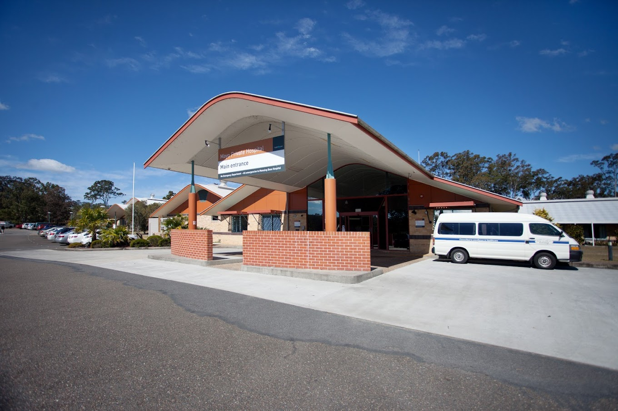
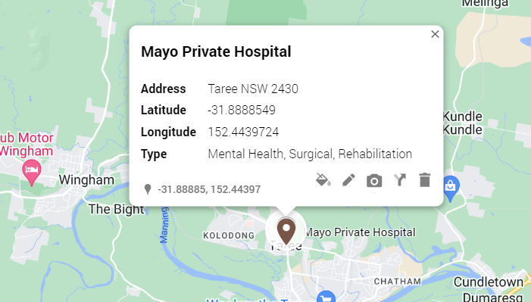
Mayo Private Hospital
Rating
3.3 (29)
Area Population
16,835
Key Mental Health Doctors:
Dr Jawad Adil
Dr Rekha Nassa
Dr Christopher Pollock
Competitors:
Manning Base Hospital: 3.2(134)
Local GP Surgeries
Manning Valley Medical Practice: 2.9(24)
Wynter Street Medical Centre: 4.0(17)
River Street Surgery (now Horizon Medical): 4.5(8)
Allan Johnson Dr: 3.6(8)
Dr M Ghaly: 4.6(16)
SunDoctors Skin Cancer Clinic Taree: 4.5(44)
Albert Street Dental Practice: 4.8(55)
Negative Google Reviews
Warning Against Dr. Michael Lau
Appointment Mismanagement with Dr. Pollock
Medication Negligence by Dr. Christopher Pollock
Concerns about Continuation of Service
Beds
79
Credentialed Specialists
97
General Surgery Unit
Yes
Mental Health Unit
Yes

Slide 19
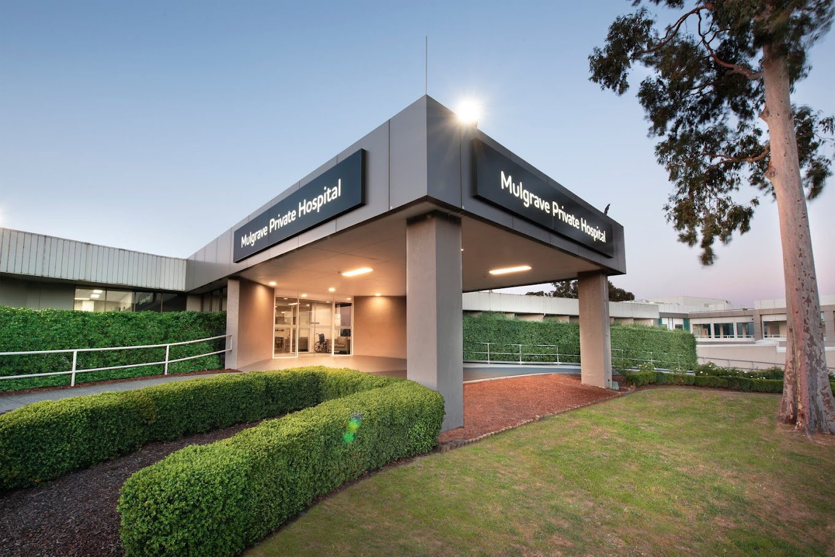
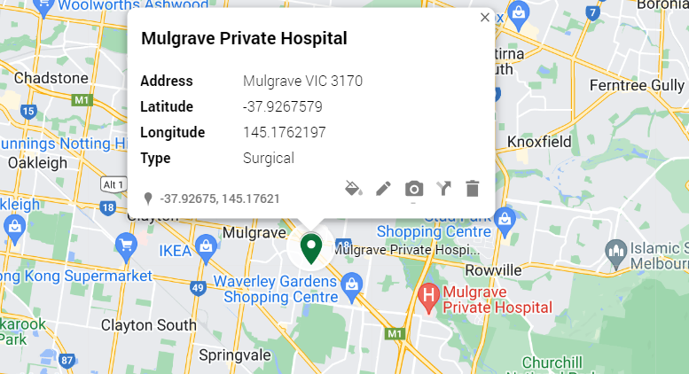
Mulgrave Private Hospital
Rating
4.1 (420)
Area Population
20,218
Key General Surgery Doctors:
Here are the names of the doctors mentioned:
Mr Travis Ackermann
Associate Professor Paul Cashin
Dr Yuan Cheng
Dr Thomas Suhardja
Mr Kostas Syrrakos
Competitors:
Valley Private Hospital: 4.1(7)
Local GP Surgeries
Valewood Clinic: 4.3(299)
United Medical Centre Waverley: 4.8(517)
SIA Mulgrave Medical and Cosmetic Centre: 4.6(361)
Doctors at Brandon Park: 4.3(131)
Mulgrave Private Hospital: 4.1(420)
Negative Google Reviews
Neglectful Elderly Care
Negligent Surgical Practices
Unprofessional Billing Practices
Long Wait Times
Exorbitant Fees for Emergency Care
Inpatient Beds
240
Emergency Services
24 hrs
Acquired by
Healthe Care
June 2007

Slide 20
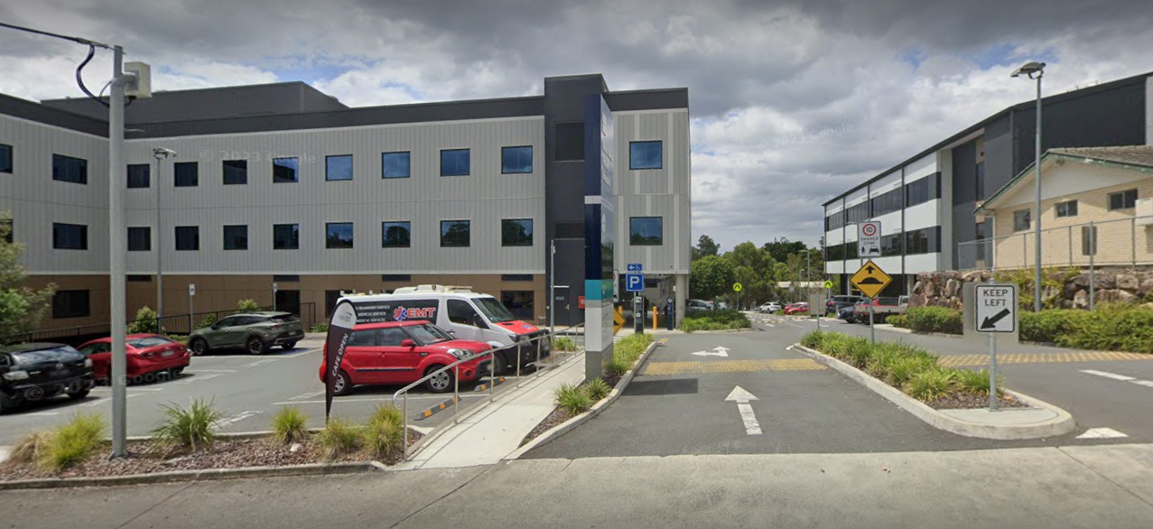
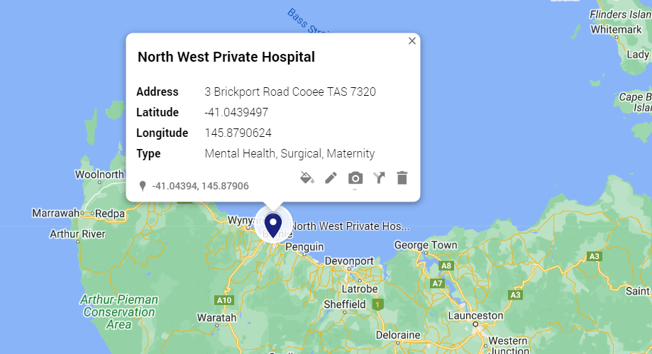
NorthWest Private Hospital
Rating
4.1 (134)
Area Population
3,217
Key Mental Health Doctors:
Dr Manoj Ravindran
Competitors:
Northwest Regional Hospital: 3.0(63)
Northwest Medical Center: 2.7(3)
Northwest Pathology: 4.7(3)
Local GP Surgeries
Burnie GP Super Clinic: 3.2 (24)
NorthWest Medical Center: 2.7 (3)
Bass House Surgery : Dr. Douglas Dow: 2.3 (3)
Burnie General Practice: 3.1 (29)
Negative Google Reviews
Maternity Ward Mismanagement
Poor Post: surgery Care
Lack of Empathy
Inadequate Neonatal Care
Allergy Mismanagement
Surgical Malpractice
Beds
48
Maternity Births
1,000 annually
Inpatient Admissions
6,000 annually
Satisfaction
95%
Mental Health Unit
Yes

Slide 21
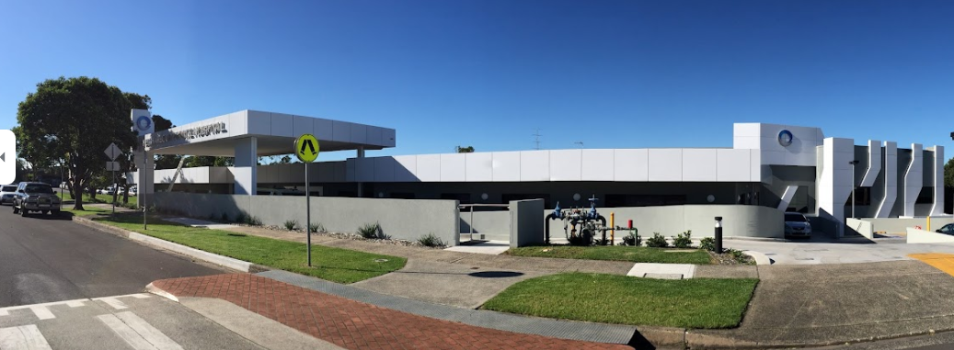
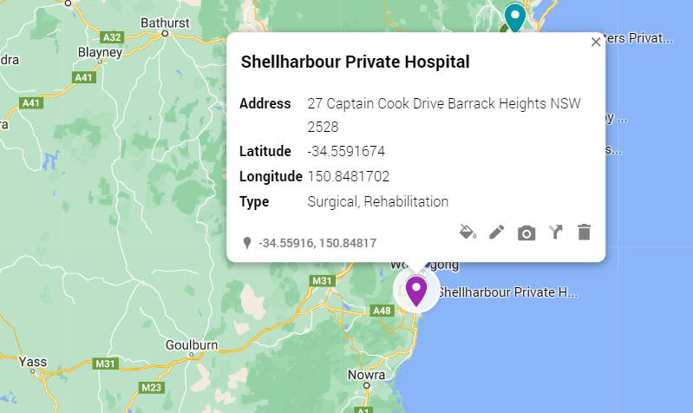
Shellharbour Private Hospital
Rating
4.3 (31)
Area Population
5,389
Key General Surgery Doctors:
Dr Dragos Iorgulescu
A/Prof Mouhannad Jaber
Dr Jason Maani
Dr Mario Malkoun
Dr Andrew Malouf
Dr Marie Shella De Robles
Competitors:
Shellharbour Hospital: 3.1(107)
Shellharbour Medical Centre: 4.6(199)
Centre Health Medical Centre: 2.6(82)
Illawarra Rehabilitation Clinic: 5.0(33)
Local GP Surgeries
Centre Health Medical Centre: 2.6 (82)
Lakeside Medical Practice Warilla: 4.4 (163)
Shellharbour City General Practice: 4.1 (44)
Shellharbour Medical Centre: 4.6 (199)
Negative Google Reviews
Restrictive Visiting Hours
Beds
60
Private Patients Rooms
29
Operating Theaters
3
Group Therapy Programs
10
Recovery Day Beds
5
Hydrotherapy Pool
Yes

Slide 22
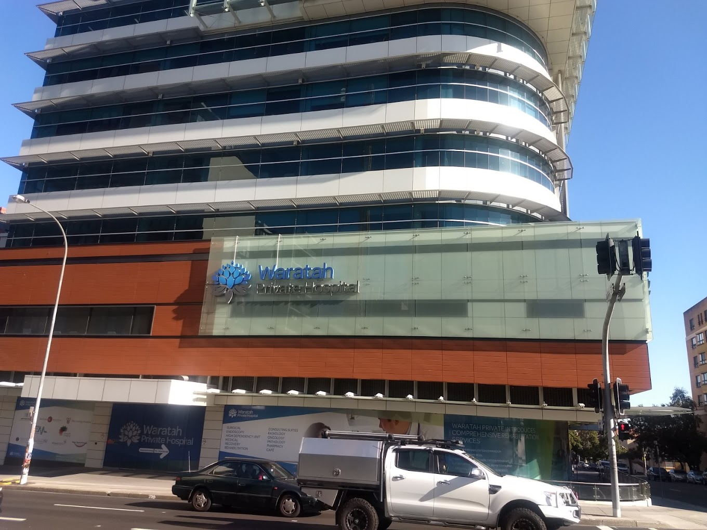
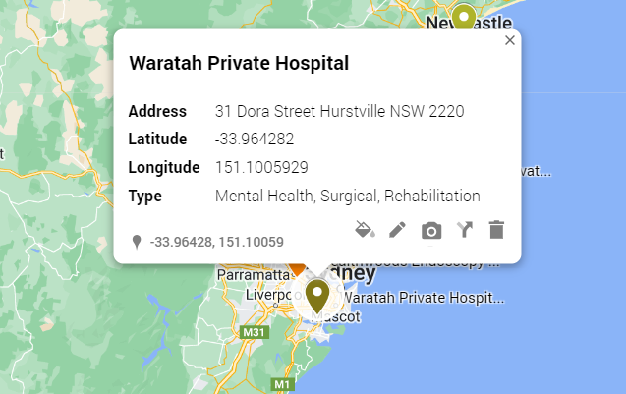
Waratah Private Hospital
Rating
3.6 (135)
Area Population
31,444
Key Mental Health Doctors:
Dr Kiran Nair
Dr Andrew Youssef
Competitors:
Hurstville Private Hospital: 3.8(117)
Local GP Surgeries
1. Hurstville Medical Practice: 3.5 (162)
2. MedFirst Medical Centre: 4.5(971)
3. Criniti Medical Practice: 4.9(256)
4. Hurstville City Medical Centre: 3.6 (527)
5. South Hurstville Family Practice: 4.9(305)
8. Myhealth Hurstville: 3.5 (403)
Negative Google Reviews
Scheduling Discrepancy
Medication Misplacement
Neglectful Staff
Cruel Discharge Policy
Dishonest Practitioner
Beds
120+
Operating Theatres
6
Inpatient Ward Beds
31

Slide 23
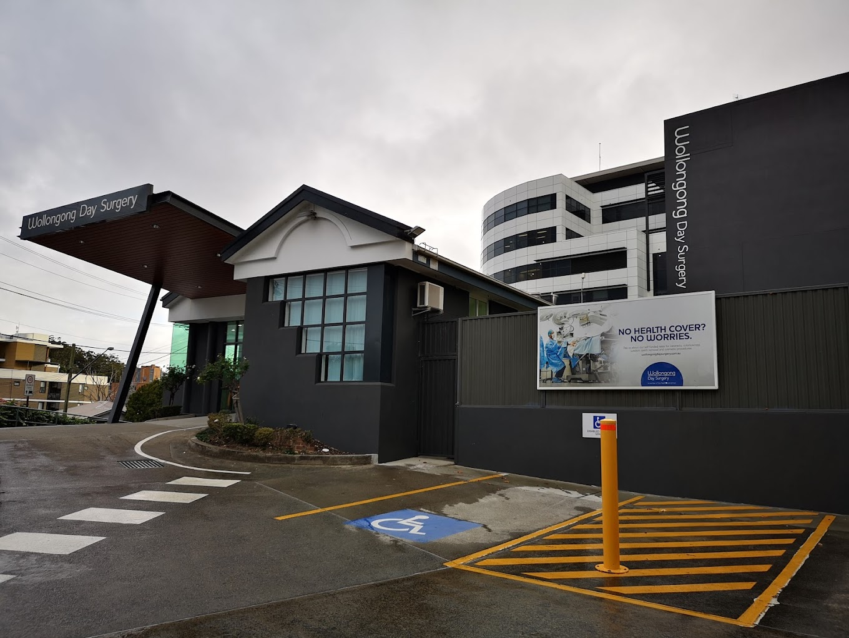
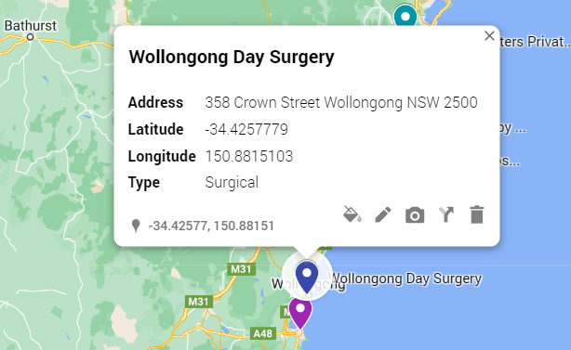
Wollongong Day Surgery
Rating
4.2 (22)
Area Population
312,000
Key General Surgery Doctors:
Here are the names of the doctors mentioned:
Dr Khalid Ahmed
Dr Beshoy Farah
Dr Mario Malkoun
Dr Marie Sheela De Robles
Dr Anik Sarkar
Competitors:
Wollongong Hospital: 3.0(338)
Local GP Surgeries
Illawarra General Practice: 4.8 (225)
Ochre Medical Centre Wollongong: 4.8(241)
Illawarra Family Medical Centre: 4.6(263)
City Medical Centre Wollongong: 4.6 (113)
TeamMed Medical Centre: 4.6(481)
Negative Google Reviews
No as such negative reviews last year
Procedures in 2017
5,576
Patient Satisfaction
96%
Day Surgary Unit
Yes

